Slide 1
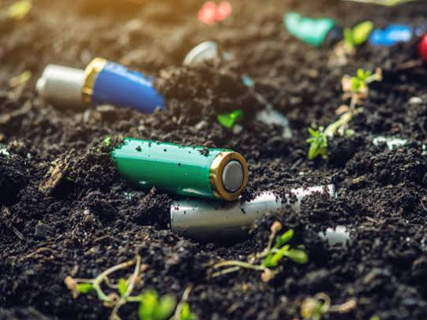
Soil pollution
Name:-P. Anand babu
Reg no:-192110413
Sub code:-UBA3366(POM)
Faculty :-Dr.k vijay bhaskar

Slide 2

Contents
Abstract
Problem Identification
Introduction
Objectives
Literature Survey
Google survey
Discussion
Suggestions
Conclusion
References

Slide 3
Abstract
Soil pollution is becoming a greater threat to the environment, especially as populations and industrial economies expand. There are studies to suggest that several plant species may be useful in reducing the migration of such pollution further down the soil column or perhaps even into the ground water.

Slide 4
Problem identification
Soil pollution causes a chain reaction it alters soil bio-diversity ,reduces soil organic matters and capacity to act as a filter.
It also contaminates the underground water
Man made: Natural causes:-
Urbanization 1. volcanic eruptions
Mining 2. Landslides
Industrial wastes
Agricultural wastes ..

Slide 5
Introduction
Soil pollution can be defined as persistent of chemicals, salts, toxic compounds, radioactive materials, that have adverse effects on animal health and plant growth. There are many ways through which soils can get polluted. These are:
Discharge of industrial waste into the Earth surfaces.
Formation of contaminated water into the soil.
Solid waste seepage.

Slide 6
Objectivies
To reduce all forms of soil erosion from Agricultural Land by Soil Moisture Conservation works.
To increase agriculture productivity in sustained manner without polluting the soil health.
To minimize flood hazards in the valley bottom areas and farm lands
To protect Agricultural Land from throwing of sand by the rivers during flood season.

Slide 7
Literature Survey
Soil pollution impacts in earths crust
IRFAN SAFI (July 2022)
Soil, the uppermost layer of the earth’s crust is a mixture of many solid, liquid and gaseous substances having both living and non-living matter such as mineral particles, decaying organic matter, microbes along with water and air contained in pore spaces.

Slide 8
A specific reason for soil pollution in earth are human wastes
2.Naiem Haque (June 2019)
The world is more connected and all the aspects of the environment are interlinked with one another more than we see with our naked eyes or even sense with our five sense organs in a given moment. .
Pesticides effects the soil fertility on agricultural lands
3.Lia Matchavariani (June 2019)
Soils contaminated from water or air and by artificially applied toxic substances from pesticides, as well as mineral fertilizers, accumulate toxic elements, including heavy metals, having an extremely adverse impact on the living organisms.

Slide 9
Soil pollution by metals from mining
4.Luma Nnaji Mohammed Tawfiq (June 2018)
In this paper the concentrations of heavy metals such: lead, chromium, nickel and cadmium, were measured in the zones of Baghdad city in Iraq thought to be deeply contaminated at depth (0-30 cm) to estimate the rate of pollution in soil.
Industries activities causes soil pollution
5.Anil kumar (dec 2017)
Although soil is a non-renewable natural resource, human has increasingly used it as a contaminant sink since industrial Revolution. . The soil pollution occurs when amounts of some soil elements and other substances may exceed levels recommended for the health of humans, animals, or plants.

Slide 10

Google survey

Slide 11
Discussion
Soil pollution is a type of pollution that is creating and increasing by humans. The main causes are throwing plastic things like polithin, plastic bags etc. in different places.
Some another causes like Landfills, wastage of industries coming with water, mixing with it and decompose in the soil.
Using pesticides is a cause for decreasing the soil fertility.

Slide 12
Suggestions
Plant more trees.
Use natural-alternatives to toxic substances.
Eat sustainable foodstuff.
Recycle battries properly.
Produce homemade compost.
Deforestation and afforestation should be promoted.
Encourage more Eco-friendly.

Slide 13
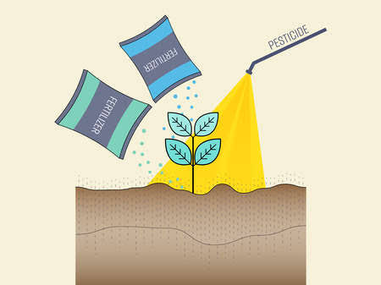
Conclusion
In conclusion, The soil pollution is an environmental issue that touches on all aspects of life. It is causes by human activities, which can be controlled. The Consequences of soil pollution is similar to other forms of pollution because of the nature of pollutants are chemicals. Health of living things relies on a clean environment. Pollution is any damage that we cause to the environment And Nobody can live without polluting our planet.

Slide 14
References
Alkorta, I., Hernandez-Allica, J., Becerril, J.M., Amezaga, I., Albizu, I., Onaindia, M., & Garbisu, C. Chelate-Enhanced phytoremediation of soils polluted with heavy metals. Reviews in Environmental Science and Bio/Technology 3:55-70. 2004.
Amusan, A.A., Bada, S.B., & Salami, A.T. Effect of Traffic Density on Heavy Metal Content of Soil and Vegetation along Roadsides in Osun State, Nigeria. West African Journal of Applied Ecology 4:107-114. 2003.
Ayodele, J.T. & Oluyomi, C.D. Grass contamination by trace metals from road traffic. Journal of Environmental Chemistry and Ecotoxicology 3(3):60-67. 2011. Cervantes, H.F.P. An Evaluation of Metal Transport from Shoulder Highway Sections into Roadside Soils Due to Atmospheric and Runoff Processes. Ph.D. Thesis, University of British Columbia. 2005.

Slide 15
Cooper, E.M., Sims, J.T., Cunningham, S.D., Huang, J.W., & Berti, W.R. Chelate- Assisted Phytoextraction of Lead from Contaminated Soils. Journal of Environmental Quality 28(6):1709- 1719. 1999.
Duong, T.T.T. & Lee, B. Determining contamination level of heavy metals in road dust from busy traffic areas with different characteristics. Journal of Environmental Management 92:554-562. 2011. Epelde, L., Hernandez-Allica, J., Becerril, J.M., Blanco, F., & Garbisu, C.
Effects of chelates on plants and soil microbial community: Comparison of EDTA and EDDS for lead phytoextraction. Science of the Total Environment 401:21-28. 2008. Humphreys, M.O. & Nicholls, M.K. Relationship between tolerance to heavy metals in Agrostis capillaris L. (A. tenuis sibth.). New Phytol 98:177-190. 1984.

